Slide 2
Page 0 (sql db entry)
After Mid-May
Input form, data type restricted, with data directly entering mysql. To test on local database so that we don't write into their db.

Slide 3
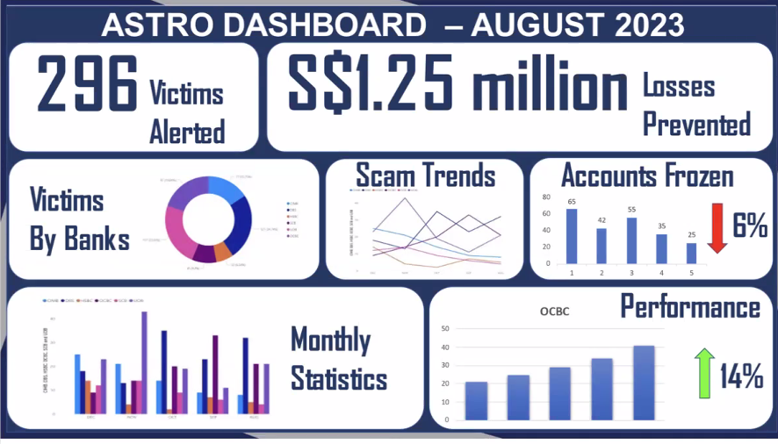
ASC dashboard
Currently in excel in sdrive (ASC to port to MySQL)
8th dashboard is phishpulse

Slide 4
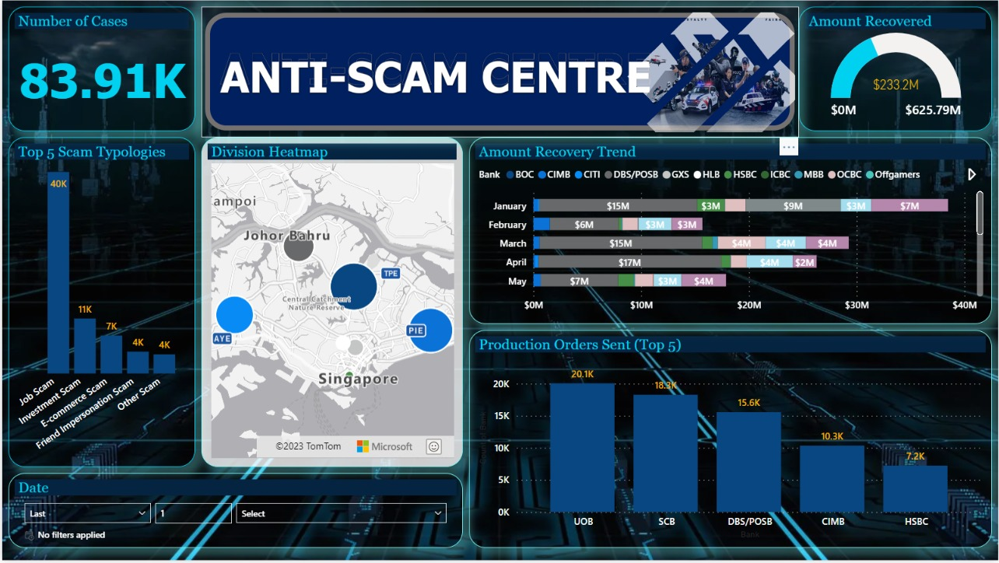
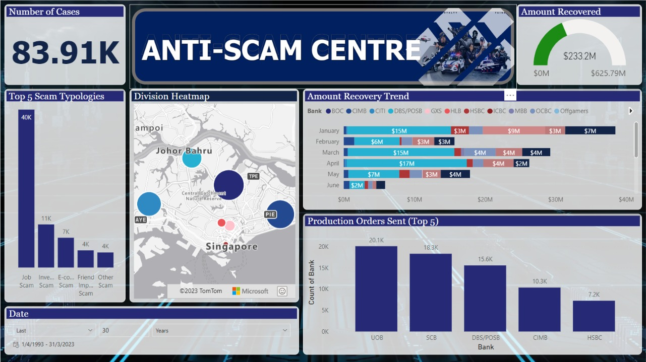
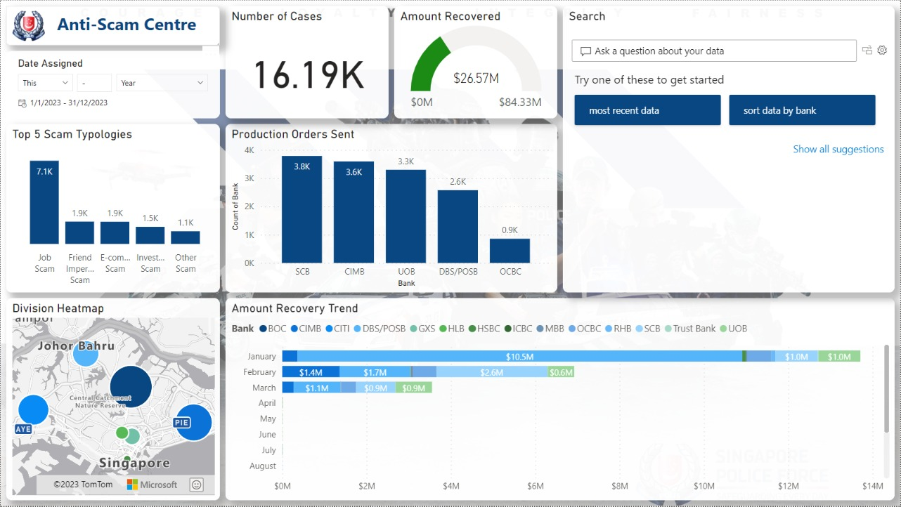
Design 1
Design 2
Design 3

Slide 5
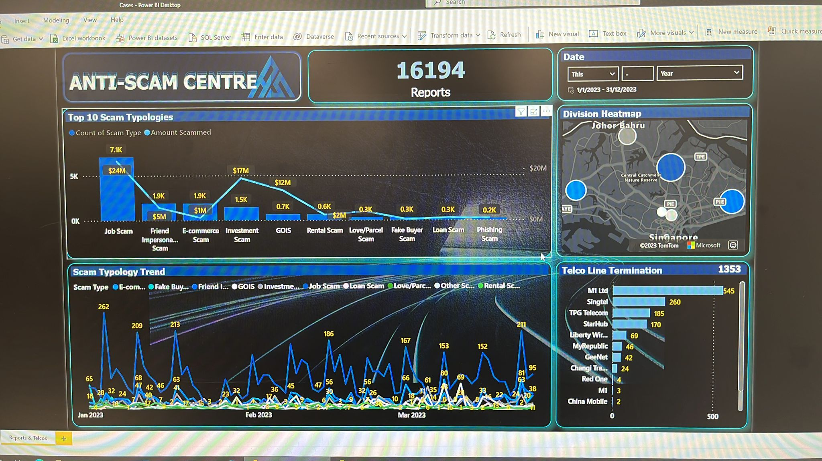
Page 1 (Overview). No scrolling. Real time data piping from DB
Use a cleaner bg that doesn’t interfere with the chart
Don’t have this in Astro. To match telco_report_number char with separate excel col ‘PO Reference’

Slide 6
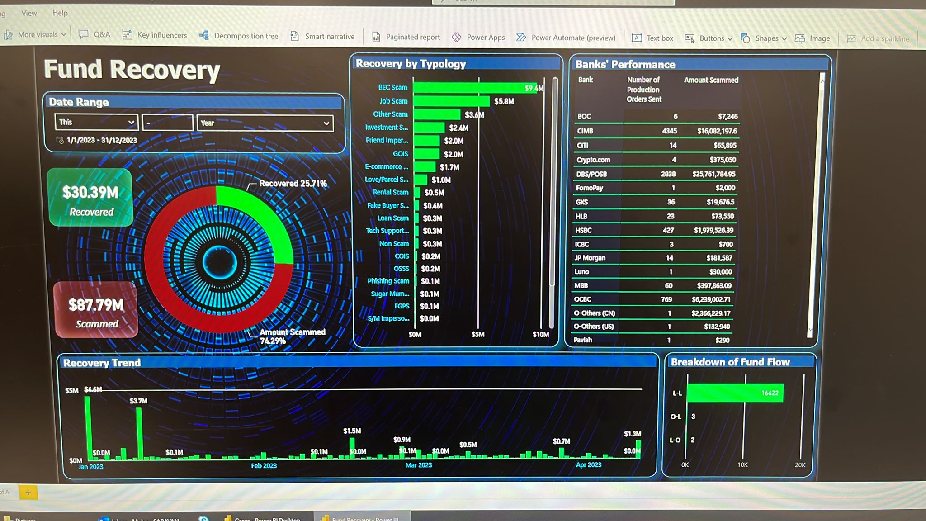
Page 2 (In-depth). No scrolling. Real time data piping from DB
Time to action min/typ/max per bank. Sort.
(datetime_production_order_served datetime) - (datetime_bank_account_frozen datetime ) = how fast/slow different banks take to react
This is a bg, not part of the chart

Slide 7
Page 2A/B/C etc.
After Mid-May
Report_number: duplicate values <- unique for other fields, different cases
Pivoting based on Page2 : Report_number (>1 entry of the same number? - links), account_number/name/whatsapp num (>1 scammer/victim)

Slide 8
Mysql database login
IP Address: 119.74.24.181
Port: 3306
User: htx
Password: Police123456
Database: astro
SSL: DISABLED

Slide 9
MySql data
Report
report_number char(15)
initial_report_number char(15)
classification text
scam_type text
amount_scammed double
amount_transcated double
remarks text
division_assigned text
date_assigned date
asc_do text
referral_date varchar(255)
division text
Victim
account_holder_name text
account_holder_nric text
acount_holder_phone_number char(8)
Telco
telco_report_number char(15)
overseas_local char(3)
Actions
datetime_production_order_served datetime
datetime_bank_account_frozen datetime
date_bank_details_received date
Scammer
bank text
account_number text
phone_number char(8)
whatsap_number char(8)
online_market_place text
latest_balance_seized double
is_coporate_account tinyint(1)
If latest_balance_seized >= amount_scammed, take amount_scammed as recovery. Else, take latest_balance_seized

Slide 10
To do
Input form, data type restricted, with data directly entering mysql. To test on local database so that we don't write into their db.
Filtering based on scam type
Start/end date filtering, on mysql level (before it hits pandas level, so that the runtime is faster I think). Standard set to 1 month away from today's date
Filtering of data from identifiers of primary/secondary keys (https://programmerbay.com/difference-between-primary-key-and-secondary-key/), such as nric/bank account number. Can be a search bar to do the filter. To extend on this, a clickable display of these identifiers based on some filtering (eg. Amount lost)
Logistic regression model to predict upward/downward trend for the next day (see python's scikit-learn logistic regression)

Slide 11
Phishpulse

Slide 12
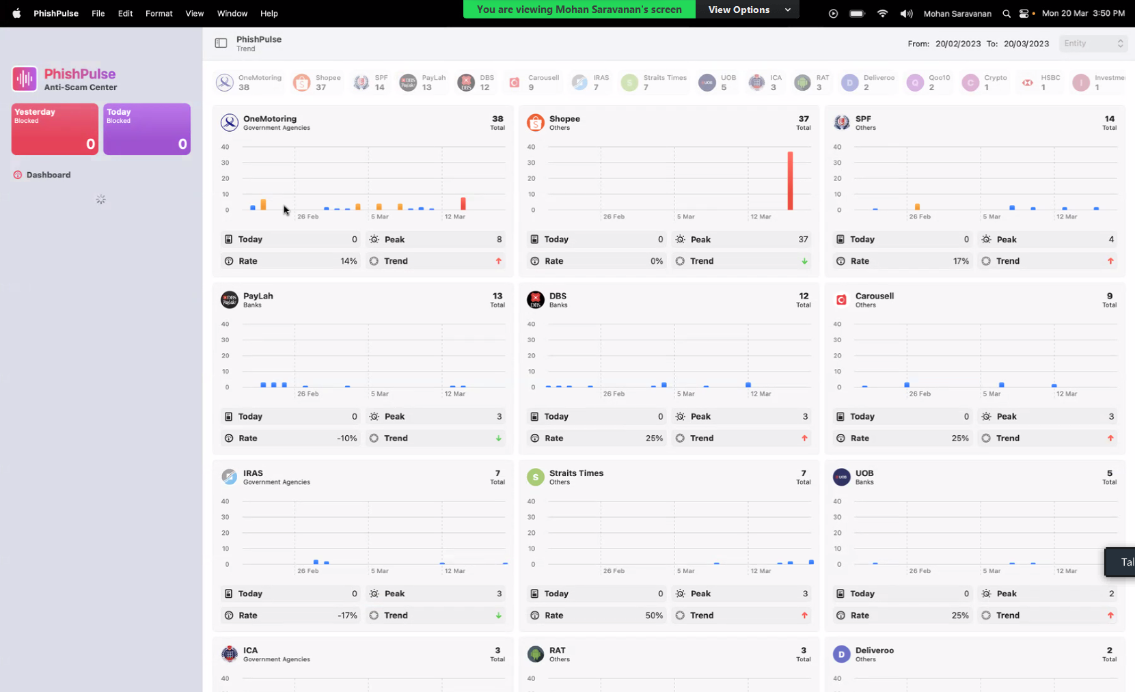
Past 30 days record.
Total number of websites
All stored in mysql
Rate = past certain threshold (e.g. how many days out of 30 days past threshold of 8, e.g. cumulative of past 30 days)
Trend: pass values into linear regression model

Slide 13
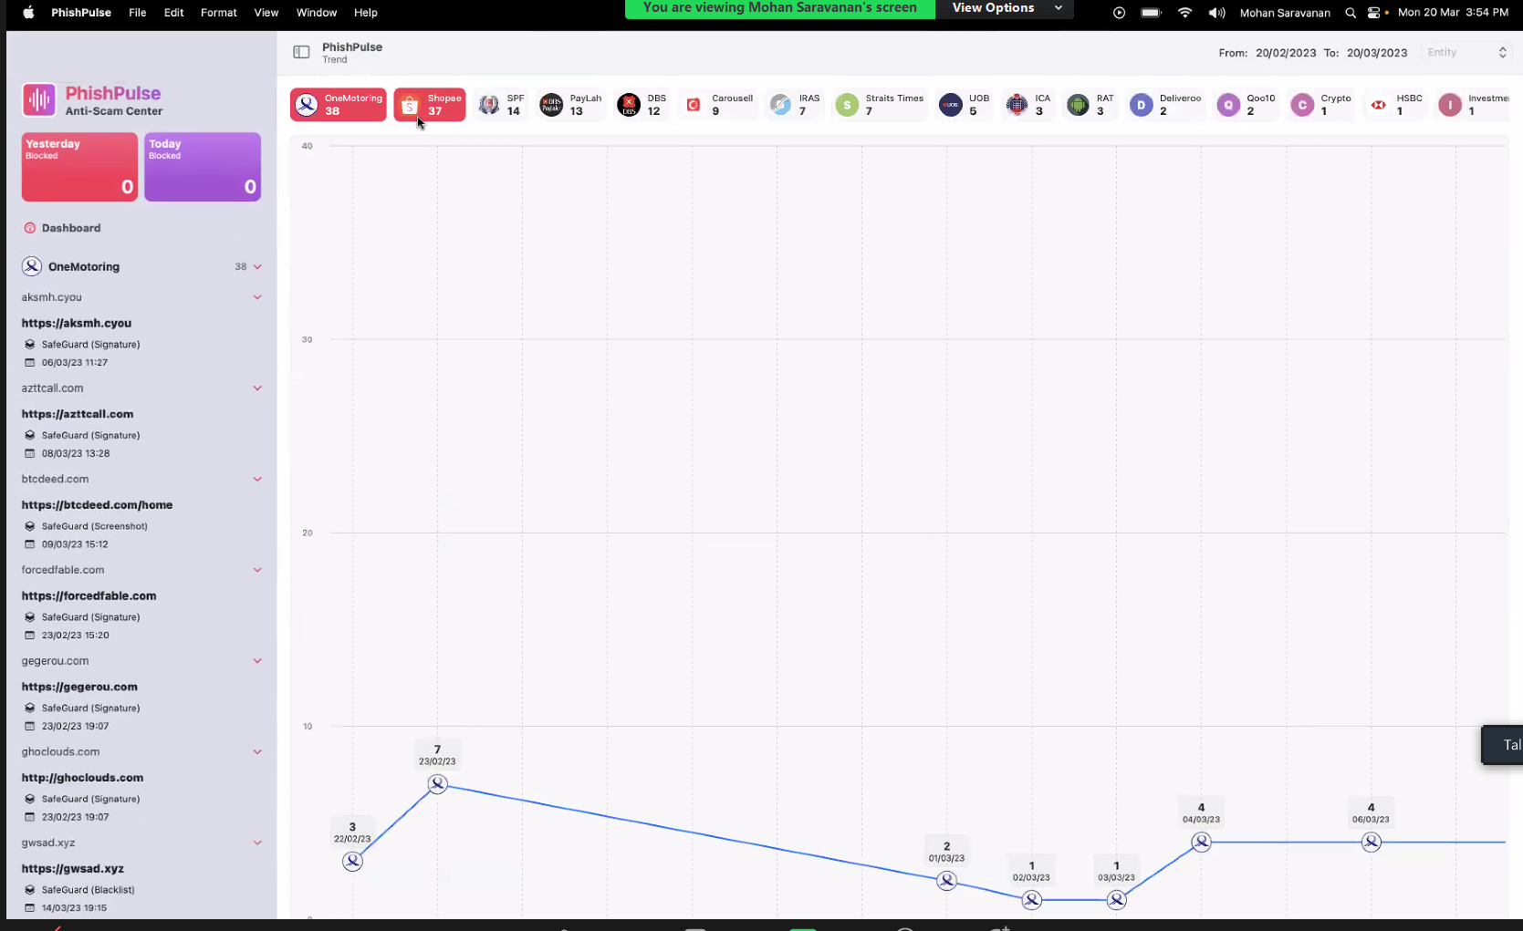

Slide 14
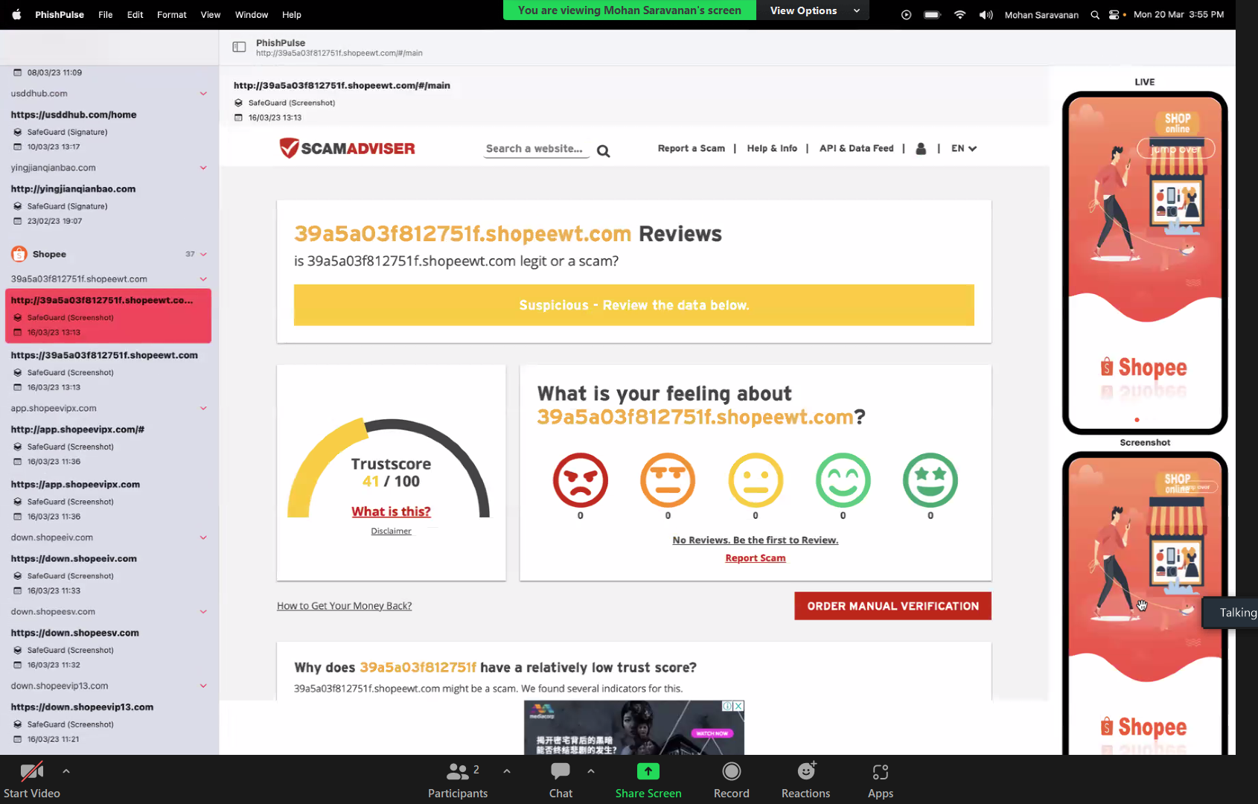
https://api-safeguard.beta.gov.sg/screenshot?api_key=ec16e2d0-1938-49d0-bb0f-a480bc2e8ceb&url_md5=4e332d51fa0c8b94a6b7a9160e10283f

